Slide 1
OS’23 Project
MILESTONE 1: PREPROCESSING
COMMAND PROMPT, SYSTEM CALLS & DYNAMIC ALLOCATOR

Slide 2
Agenda
Logistics
Part 0: Prerequisites
Pointers
LISTs in FOS
Part 1: Play with Code!
Strings
Command Prompt
Part 2: System Calls
Part 3: Dynamic Allocator
Summary & Quick Guide
How to submit?

Slide 3
Logistics
Startup Code:
FOS_PROJECT_2023_template.zip
Follow these steps to import the project folder into the eclipse
Delivery Method: GOOGLE FORMS
It’s FINAL delivery
MUST deliver the required tasks and ENSURE they’re worked correctly
Delivery Dates:
SAT of Week #5 (28/10 @11:59 PM)
Upload your code EARLY as NO EXCEPTION will be accepted.
Support:
The support for teams will be through their MENTORS ONLY (+Lecturer) during the published weekly office hours.

Slide 4
Logistics
ADVICE#1: WORK AS A TEAM
Milestone 1 Functions:
Command Prompt 🡺 2 functions
System Calls 🡺 2 requirements
Dynamic Allocator 🡺 4 functions + 1 test
Average # Functions / Member = 9 / 5 members
ADVICE#2: START immediately!
To have the chance to ask and to understand errors in your code in whatever you want during your mentor’s support before the deadline.
ADVICE#3: MUST read the ppt & doc CAREFULLY
Detailed steps
Helper ready made functions (appendices)
≈ 2 Functions on 2 Weeks

Slide 5
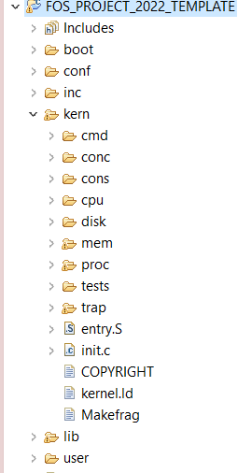




PROJECT BIG PICTURE
Cmd Prmpt
inc (.h)
lib (.c)
SysCalls
[MS1] Preprocessing
user
kern
[MS2] Memory
[MS3] CPU
SysCalls
string
Dyn Alloc

Slide 6
Pointers
PART0: PREREQUISITES

Slide 7
Memory and Pointers
Why we need pointers?! Pointers vs. Variables... Definition Data type & size Setting values Incrementing… Structure and accessing its members

Slide 8
Pointer vs Variables:
Definition
Pointers
Variables
char *ptr;
char x;

Slide 9
Pointer vs Variables:
Data type & Size
Pointers
Variables
char *ptr;
Data type:
Data type to point into it
Size of ptr:
4 Byte
Size of address bus of CPU (protected 🡪 32-bit)
char x;
Data type:
Data type of variable itself
Size of x:
1 Byte 🡪 sizeof(char)

Slide 10
Pointer vs Variables:
Assigning value
Pointers
Variables
Assigning value:
char *c_ptr = 0x100;
//changes the pointed address
c_ptr = 0x50;
c_ptr = &x;
//changes the value within the pointed address
*c_ptr = 'A';
Assigning value:
char x = 10;
x = 50;
x = 'A';

Slide 11
Pointer vs Variables:
Incrementing
Pointers
Variables
increment:
char *c_ptr = 0x100;
c_ptr++; // ptr=0x101
int *i_ptr = 0x100;
i_ptr++; // ptr=0x104
Increases by the size of its type
increment:
char x = 10;
x++; // x=11
int x = 10;
x++; // x=11
Increases by 1

Slide 12
Pointer vs Variables:
Structure & its members
struct MyStruct {
int x, y;
char c;
char* c_ptr;
}
Pointers
Variables
Init. & Assign.:
Struct MyStruct *my_struct;
my_struct->x = 5;
my_struct->c = 'A';
(*my_struct).y = 10
Init. & Assign.:
Struct MyStruct my_struct;
my_struct.x = 5;
my_struct.c = 'A';

Slide 13

Pointer vs Variables:
Structure & its members
struct MyStruct {
int x, y;
char c;
char* c_ptr;
};
Pointers
Variables
Init. & Assign.:
Struct MyStruct *my_struct;
my_struct = 100;
my_struct++;
increases by size of struct
Init. & Assign.:
Struct MyStruct my_struct;
// ptr=113

Slide 14
LISTs in FOS
PART0: PREREQUISITES

Slide 15
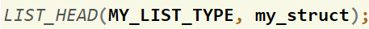
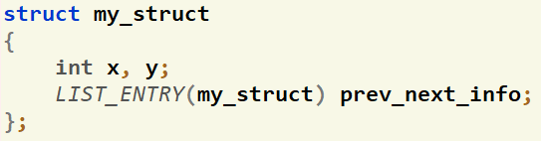
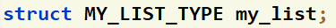
How to define LISTS in FOS?
To define a LIST that points to objects of type struct my_struct:
Create a list head that holds info about the list (size, head, tail).
LIST_HEAD([LIST_TYPE_DEF], [STRUCT NAME THAT WILL POINTS TO]);
Ex:
Add next and previous pointers to the struct
LIST_ENTRY([STRUCT NAME]) prev_next_info;
Ex:
Define your list
struct [LIST_TYPE_DEF] my_list
Ex:

Slide 16
How to use LISTS?
Set of helper ready made functions are available in Appendix II here
LIST_INIT(…)
LIST_INSERT_HEAD(…)
LIST_SIZE(…)
LIST_REMOVE(…)
…
IMPORTANT: you should pass the list to any of these functions by reference (i.e. Put & before the name of the list)

Slide 17
Agenda
Logistics
Part 0: Prerequisites
Pointers
LISTs in FOS
Part 1: Play with Code!
Strings
Command Prompt
Part 2: System Calls
Part 3: Dynamic Allocator
Summary & Quick Guide
How to submit?

Slide 18
Part1: Play with Code!
The objective of this part is to break the ice with the code and start navigate in it easily.
Assess: using pointers & lists
Required:
# | Function | File(s)
1 | str2lower() | lib/string.c
2 | process_command() | Essential declarations: kern/cmd/command_prompt.h, kern/cmd/commands.h, kern/cmd/commands.c Function definition TODO: kern/cmd/command_prompt.c

Slide 19
#1: str2lower
Declaration:
char* str2lower(char *dst, const char *src)
Description:
Convert all alphabet chars of a given string “src” to lower case, store it in “dst” and return it
Testing:
[UNSEEN] Test at your own…

Slide 20
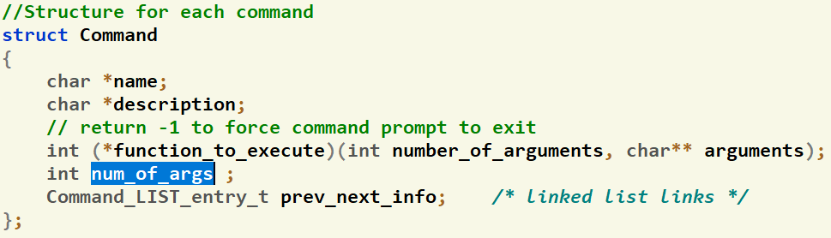
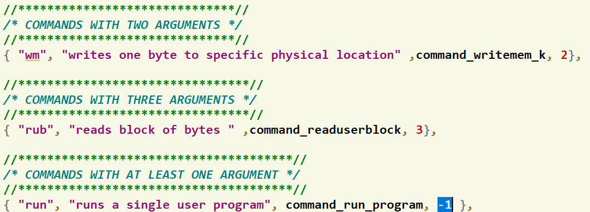
#2: process_command
Givens:
# of arguments per command
Linked list prev-next pointers
Initializations

Slide 21
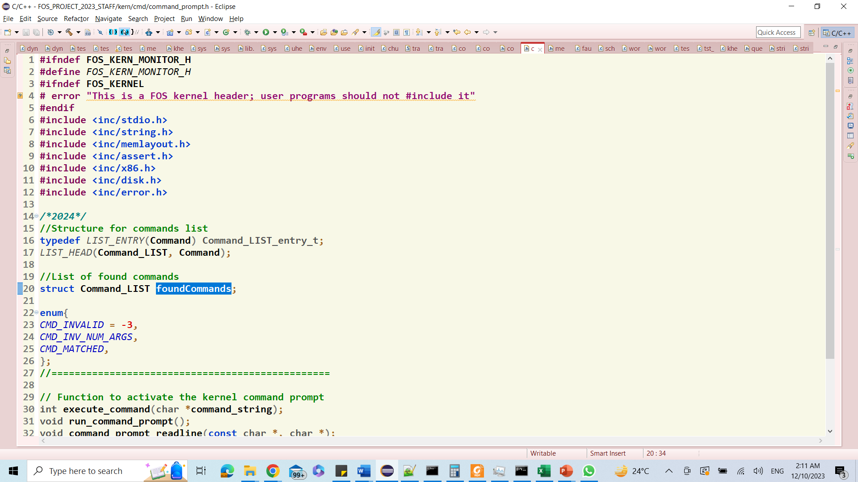
#2: process_command
Givens:
List of found commands (if any)
Hold objects from struct Command
Command Status

Slide 22
#2: process_command
Declaration:
int process_command(int number_of_arguments, char** arguments)
Description:
Status | Return | Content of List
1) invalid command (i.e. command chars are not exist/matched with any other command) | CMD_INVALID | Empty
2) command is found BUT with invalid number of arguments | CMD_INV_NUM_ARGS | Found command
3) command is not found BUT its chars are subsequence-matched with one or more commands | CMD_MATCHED | All matched commands
4) command is found with correct number of arguments | Index of the found command in “commands“ array | Empty

Slide 23
#2: process_command
Testing:
[UNSEEN] At your own…
Examples:
FOS> kernel_info 🡺 should execute the kernel_info command
FOS> clk 🡺 should print the commands that contains “clk” as subsequence
[1] nclock
[2] modifiedclock
[3] clock
FOS> wm 🡺 should print invalid number of args
wm: invalid number of args.
FOS> smm 🡺 invalid command (already exist in the given code)
Unknown command “smm”
Helper Functions: refer to Appendix I

Slide 24
Agenda
Logistics
Part 0: Prerequisites
Pointers
LISTs in FOS
Part 1: Play with Code!
Strings
Command Prompt
Part 2: System Calls
Part 3: Dynamic Allocator
Summary & Quick Guide
How to submit?

Slide 25

Idea of System Calls
Where in Code?
lib/syscall.c
kern/trap/trap.c
kern/trap/syscall.c
inc/syscall.h
It’s OS procedure that executes privileged instructions (e.g., I/O); (API exported by kernel)
Causes a trap, which
Switch to the kernel mode
Look in Interrupt Descriptor Table (IDT)
Jumps to the syscall handler in the kernel.
The syscall handler do the following:
Save caller's state (CPU Reg’s) so it can restore control to the user process later.
Check the system call number (Typically, a number associated with each system call)
Call associated function that serve the given system call and pass to it the caller’s parameters
After finish, restore caller’s state (CPU Reg’s)
use iret instruction to return to user mode.
User Program
int main()
{
… ;
cprintf(…)
… ;
interrupt
?
ireturn
User Mode
How to pass params/return value from/to user to kernel or vice versa?
OS should verify the caller's parameters.
IDT
Kernel Mode
Read()
…
1
Syscall Handler
SYS_NO.?
Display(…)
…
2
RAM
Open(…)
…
3
CPU Reg’s
...
CPU Reg’s
Save
Caller State
Load
Print(…)
…
N

Slide 26
#3: Syscalls
Description:
Implement/handle THREE system calls.
Hint: have a look on any of the existing system calls to get the idea
Testing:
FOS> run tst_syscalls_1 10
Syscall in User Side (lib/syscall.c) | Corresponding Fun in Kernel Side (kern/trap/syscall.c) | Used In
void* sys_sbrk(int increment) | void* sys_sbrk(int increment) | MS#2
void sys_allocate_user_mem(uint32 virtual_address, uint32 size) | void sys_allocate_user_mem(uint32 virtual_address, uint32 size) | MS#2
void sys_free_user_mem(uint32 virtual_address, uint32 size) | void sys_free_user_mem(uint32 virtual_address, uint32 size) | MS#2

Slide 27
#4: Params Validation
Description:
At kernel side: need to validate any address (or range) that is passed from user to kernel to ensure that:
NOT null pointers,
NOT illegal pointers (e.g. pointing to kernel memory) (i.e. above USER_LIMIT),
NOT invalid pointers (e.g. pointing to unmapped memory),
Check only the first two cases. If violated, kernel should kill the user program by calling:
sched_kill_env(curenv->env_id);
Third case cause a “page fault” that you can handle by modifying the code for page_fault() in MS#2.
This technique is normally faster because it takes advantage of the processor’s MMU, so it tends to be used in real kernels (including Linux).
Testing:
FOS> run tst_syscalls_2 10

Slide 28
Agenda
Logistics
Part 0: Prerequisites
Pointers
LISTs in FOS
Part 1: Play with Code!
Strings
Command Prompt
Part 2: System Calls
Part 3: Dynamic Allocator
Summary & Quick Guide
How to submit?

Slide 29
Objective
Handle memory blocks dynamically by using LISTS to allocate or free any required space in heap by either OS or any user program

Slide 30
Idea: Heap
a space of memory, continuous in the virtual address space of a process, with three bounds:
The bottom of the heap.
The top of the heap, known as the break. The break can be changed using sbrk.
The hard limit of the heap, which the break can’t surpass.
Notes:
The break marks the end of the mapped memory space. It should be the first address past the end of the heap. Above the break lies virtual addresses which have not been mapped to physical addresses by the operating system. The user program should be able to write data starting at the start of the heap, up to and not including the segment break. You should implement sbrk as a new system call in FOS.

Slide 31
Idea: sbrk
void* sbrk(int increment);
manipulate the position of the break
If it moves the segment break to increase the size of the heap, pages should be allocated and mapped as necessary.
If it moves the segment break to decrease the size of the heap, pages that no longer contain part of the heap should be deallocated, as necessary.
Pages are allocated or deallocated only if the segment break crosses a page boundary.
More details about sbrk and its implementation will be in MS#2 isA

Slide 32
Idea: Data Structure
A simple memory allocator for the heap can be implemented using a linked list data structure
each allocated block of memory will be preceded by a header containing metadata.
prev, next: Pointers to metadata of adjacent blocks
free: Boolean describing whether or not this block is free
size: Size of the block of memory (including the size of its meta data)

Slide 33
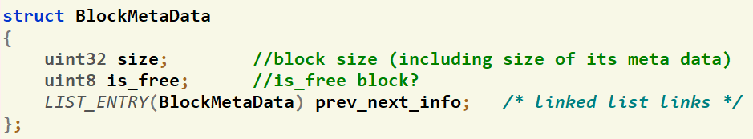
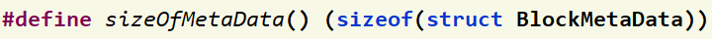

Code: Given Data Structures
Struct containing the metadata of each block
Macro to get the size of the metadata struct
List head struct (MemBlock_LIST) to be used to define any list of BlockMetaData

Slide 34
Code: Given Functions
Get size of the block at the given address
uint32 get_block_size(void* va);
Check the status of the block at the given address
int8 is_free_block(void* va);
Print the elements of a given block list
void print_blocks_list(struct MemBlock_LIST list);

Slide 35
#5: Initialize
void initialize_dynamic_allocator
(uint32 daStart, uint32 initSizeOfAllocatedSpace);
Description:
Initialize the dynamic allocator starting from the given address “daStart” with the given allocated space “initSizeOfAllocatedSpace”
Block list and metadata of the first free block should be initialized here
Testing:
FOS> tst dynalloc init

Slide 36
#6: Allocate by First Fit
void *alloc_block_FF(uint32 required_size)
Description:
Find the first block the fit the required_size in addition to the size of its metadata (First Fit strategy)
If no sufficiently large free block is found, use sbrk to create more space on the heap.
If the found block of memory is so large that it can accommodate both the newly allocated block and another block in addition, then the large block is split in two; one block to hold the newly allocated block, the other to be a residual free block.

Slide 37
#6: Allocate by First Fit
void *alloc_block_FF(uint32 required_size)
Return:
Make sure the returned pointer points to the beginning of the allocated space, not metadata header.
NULL if cannot allocate the new requested size (after sbrk)
NULL if the requested size is 0.
Testing:
FOS> tst dynalloc allocff

Slide 38
#6: Allocate by First Fit – Example
.
.
.
break
2 MB
meta data
.
.
.
meta data
ptr4 = alloc_FF (2 MB)
2 MB
ptr4
meta data
meta data
1 MB
meta data
2 MB
meta data
0.5 MB
meta data
ptr3 = alloc_FF (1 MB)
ptr3
meta data
1 MB
3 MB
meta data
meta data
ptr1 = alloc_FF (1 MB)
ptr1
1 MB
meta data
meta data
4 MB
.
.
.
daStart
meta data

Slide 39
#7: Free
void free_block(void* va)
Description:
Free the previously allocated block at the given address “va”
Free doesn’t release the memory back to OS; just indicates that block is available for future use.
Must coalesce (i.e. merge) consecutive free blocks upon freeing a block that is adjacent to other free block(s).
In coalesce case, the meta data of the vanished block(s) should be cleared (set to 0) to indicate that the block is no longer valid.
do nothing if passed a NULL pointer

Slide 40
#7: Free
void free_block(void* va)
Testing:
FOS> tst dynalloc freeff

Slide 41
#7: Free – Example
.
.
.
break
2 MB
meta data
.
.
.
meta data
2 MB
ptr4
meta data
1 MB
meta data
2 MB
meta data
0.5 MB
meta data
free(ptr3)
ptr3
meta data
1 MB
3 MB
meta data
free(ptr1)
ptr1
1 MB
meta data
4 MB
.
.
.
daStart
meta data

Slide 42
#8: Reallocate by First Fit
void *realloc_block_FF(void* va, uint32 new_size)
Description:
Should resize the allocated block at va to new_size
If there’s sufficient free block in front of the allocated block 🡺 resize it in the same place
Else, relocate it to a suitable free block (if any) using First Fit strategy
If no sufficiently large free block is found, use sbrk to create more space on the heap.
Make sure you handle the case where size is less than the original size.

Slide 43
#8: Reallocate by First Fit
void *realloc_block_FF(void* va, uint32 new_size)
Return:
Address of the reallocated block.
realloc_block_FF(va, 0) is equivalent to calling free(va) and returning NULL.
realloc_block_FF(NULL, n) is equivalent to calling alloc_FF(n) and return the allocated address.
realloc_block_FF(NULL, 0) is equivalent to calling alloc_FF(0), which should just return NULL.
Testing:
FOS> tst dynalloc reallocff [PARTIAL TEST]

Slide 44
#9: Complete Test of Realloc
void test_realloc_block_FF()
Description:
The given test of realloc doesn’t handle all possible cases
It’s required to pick-up the missing cases and test them to ensure that your implementation is 100% correct.

Slide 45
BONUS: Allocate by Best Fit
void *alloc_block_BF(uint32 size)
Description:
Find the smallest block that fit the required size in addition to the size of its metadata (Best Fit strategy)
If no sufficiently large free block is found, use sbrk to create more space on the heap.
If the found block of memory is so large that it can accommodate both the newly allocated block and another block in addition, then the large block is split in two; one block to hold the newly allocated block, the other to be a residual free block.

Slide 46
BONUS: Allocate by Best Fit
void *alloc_block_BF(uint32 size)
Return:
Make sure the returned pointer points to the beginning of the allocated space, not metadata header.
NULL if cannot allocate the new requested size
NULL if the requested size is 0.
Testing:
FOS> tst dynalloc allocbf
FOS> tst dynalloc freebf

Slide 47
Agenda
Logistics
Part 0: Prerequisites
Pointers
LISTs in FOS
Part 1: Play with Code!
Strings
Command Prompt
Part 2: System Calls
Part 3: Dynamic Allocator
Summary & Quick Guide
How to submit?

Slide 48
Summary
Module | Function | Difficulty | Testing | Files
Play with Code | str2lower | L1 | UNSEEN – Test at your own | lib/string.c
 | process_command | L2 | UNSEEN – Test at your own | kern/cmd/command_prompt.c
System Calls | 3 system calls | L2 | FOS> run tst_syscalls_1 10 | lib/syscall.c, kern/trap/trap.c, kern/trap/syscall.c, inc/syscall.h
 | params validation | L1 | FOS> run tst_syscalls_2 10
Dynamic Allocator | initialize | L1 | FOS> tst dynalloc init | lib/dynamic_allocator.c
 | alloc_block_FF | L2 | FOS> tst dynalloc allocff
 | free_block | L3 | FOS> tst dynalloc freeff
 | realloc_block_FF | L3 | FOS> tst dynalloc reallocff (Partial)
 | test_realloc_block_FF | L2 | UNSEEN – Test at your own | kern/tests/test_dynamic_allocator.c
 | (+) alloc_block_BF | L2 | FOS> tst dynalloc allocff FOS> tst dynalloc freeff | lib/dynamic_allocator.c
"Congratulations!! test [TEST NAME] completed successfully.”
To ensure the test success, a congratulations message like this MUST appear without any ERROR messages or PANICs.

Slide 49
Startup Code
FOS_PROJECT_2023_Template.Zip
Follow these steps to import the project folder into the eclipse

Slide 50
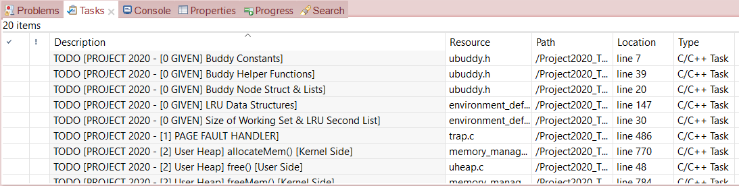
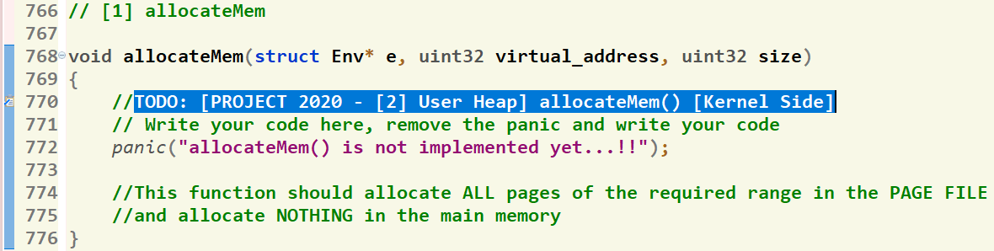
Where should I write the Code?
There’re shortcut links that direct you to the function definition
[1] Click on “Tasks” Tab
[2] Double Click on the required function
GIVEN
REQUIRED
[3] Function body, at which you should write the code
‹#›

Slide 51
Helper Ready Made Functions
Set of ready-made LIST and string functions are available to help you when writing your solution.
Detailed description can be found in this document.

Slide 52
Agenda
Logistics
Part 0: Prerequisites
Pointers
LISTs in FOS
Part 1: Play with Code!
Strings
Command Prompt
Part 2: System Calls
Part 3: Dynamic Allocator
Summary & Quick Guide
How to submit?

Slide 53
Submission Rules
Read the following instructions as the code correction is done AUTOMATICALLY. Any violation in these rules will lead to 0 and, in this case, nothing could be happened.
First ensure the following that (READ CAREFULLY):
You tested each function in a FRESH RUN and a congratulations message have been appeared.
NO CODE with errors WILL BE CORRECTED. So, CLEAN & RUN your project several times before your submission.
You submitted BEFORE the deadline by several hours to AVOID any internet problems.
DEADLINE: SAT of Week #5 (28/10 @11:59 PM)
NO DELAYED submissions WILL BE ACCEPTED.
ONLY ONE person from the team shall submit the code.
The TEAM # MUST BE CORRECT.
DON’T take the FORM LINK FROM ANYONE. OPEN the form from its LINK ONLY. Otherwise, your submission is AUTOMATICALLY CANCELLED by GOOGLE.
You MUST RECEIVE A MAIL FROM GOOGLE with your submission after clicking submit. If nothing received, re-submit again to consider your submission.

Slide 54
Submission Steps
STEPS to SUBMIT:
Step 1: Clean & run your code the last time to ensure that there are any errors.
Step 2: Create a new folder and name it by your team number ONLY. Example 1 or 95. [ANY extra chars will lead to 0].
Step 3: DELETE the “obj” folder from the “FOS_PROJECT_2023_Template”
Step 4: PASTE the “FOS_PROJECT_2023_Template” in the folder created in step #2.
Step 5: Zip the created new folder. Its name shall be like [num of your team.zip]. [ANY extra chars will lead to ZERO].
Step 6: Open the form from HERE.
Step 7: Fill your team’s info .. Any wrong information will cancel your submission, revise them well.
Step 8: Upload the zipped folder in step 5 to the form in its field.
Step 9: MUST RECEIVE A MAIL from GOOGLE with your submission, otherwise re-submit again.

Slide 55
Thank you for your care…
Enjoy making your own FOS ☺

